Slide 1
Title option (choose one and delete the other title pages; or choose your own content relevant picture)
Compelling and short title here
Month 00, 2011
Notes:
http://pixdaus.com/single.php?id=186222

Slide 2
Example content pages

Slide 3
Set-up pages are managed as a separate slide master (view -> slide master); go to the master to edit its content; this is done because this slide is repeated throughout the presentation so if you change the content once, it is changed on all set-up pages
TITLES:
Test Size: 48
Font: Bold Calibri font (should already be pre-set in the slide master)
Box is moveable to highlight chapter
Setup slide:
Text size: 44 font bold
Font: Trebuchet MS
Spacing – 27 pts

Slide 4
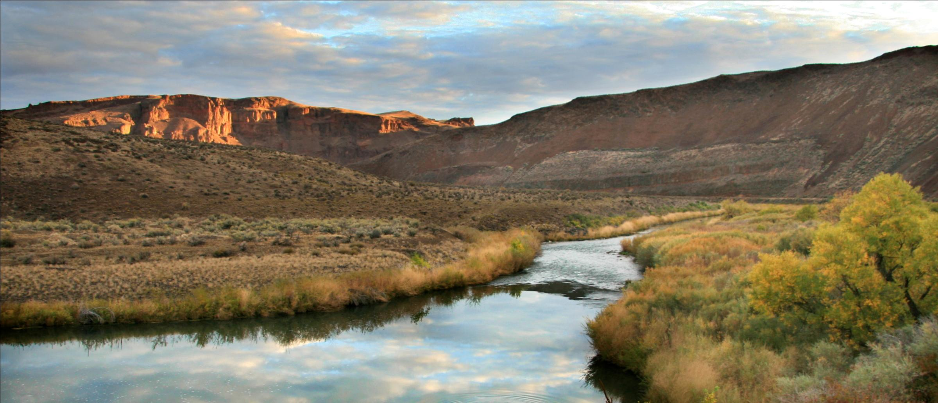
Our work on this river focused on barrier removal
Title only layout
Named River, ST
Location of picture
Text Size: 20
Font: Calibri
Notes:
Sources: 2011 member photo contest
SIGI is based on a selection of indicators from the Gender, Institutions and Development Data Base. In particular, it uses information on social institutions variables that are classified into family law, physical integrity, civil liberties and ownership rights. The index is the arithmetic average of 12 single indicators and measures on a scale from 0 to 1 the level of gender inequality in social institutions (higher levels indicate greater inequality).
Access to FPRH services is low
Gender disparities in finance, education, and decision-making are large
Human rights and civil liberties are limited

Slide 5
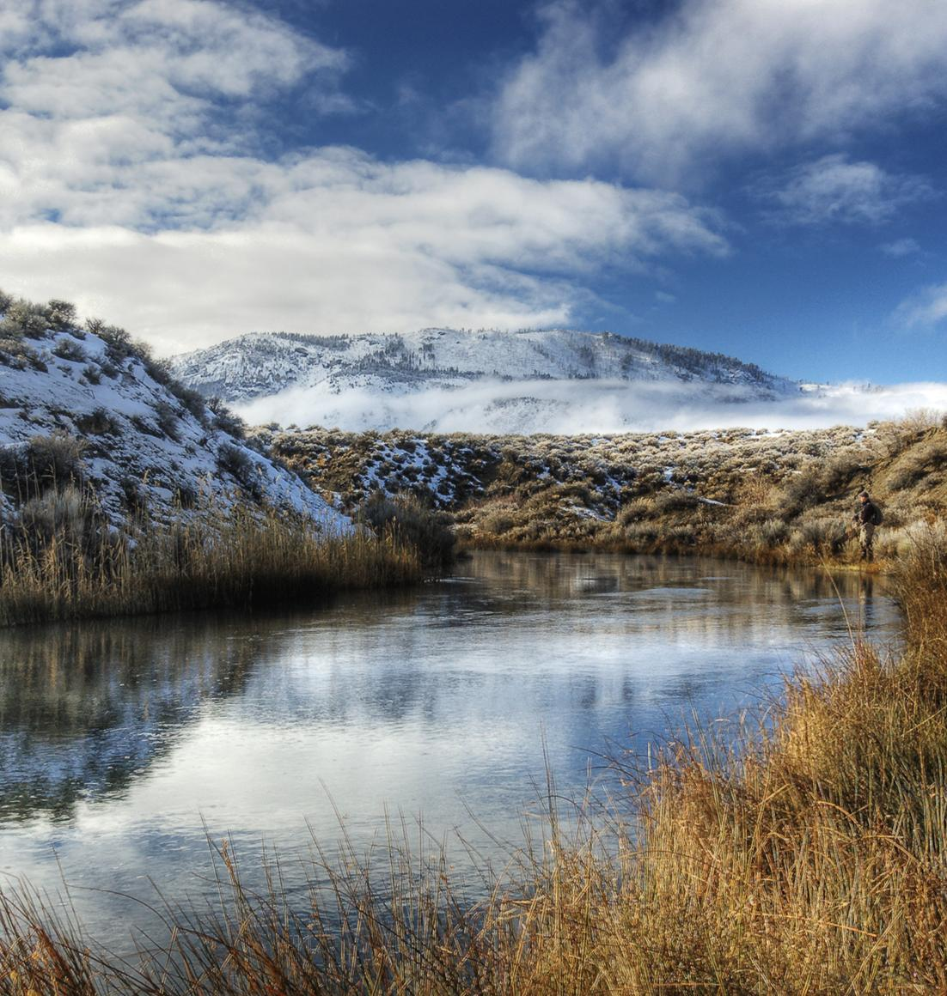
TU saved the Named River
Custom layout with pic on left
Protecting saved 6,000 acres
Reconnecting brought 500 river miles into native habitat
Restoring balanced trout with oil and gas
Sustaining supported fishing access for youth groups
Bullets
Text Size: 36
Font: Bold Calibri font (should already be pre-set in the slide master)
Named River, ST
Location of picture
Text Size: 20
Font: Calibri
Notes:
Sources: 2011 member photo contest

Slide 6
Compelling title with some thoughts here
Chart on left format
Chart title: 36 Bold
Sub-title: 28 non-bold
Category labels
32 pt font
Sources in excel
Title
Subtitle
Conclusion 1 and more thoughts
Conclusion 2 and more thoughts
Conclusion 3 and more thoughts
Bullets
Text Size: 36
Font: Bold Calibri font (should already be pre-set in the slide master)
28 pt font
Sources in excel

Slide 7
Set-up pages are managed as a separate slide master (view -> slide master); go to the master to edit its content; this is done because this slide is repeated throughout the presentation so if you change the content once, it is changed on all set-up pages
TITLES:
Text Size: 48
Font: Bold Calibri font (should already be pre-set in the slide master)
Setup slide:
Text size: 44 font bold
Font: Trebuchet MS
Spacing – 27 pts

Slide 8
Compelling title with some thoughts here
No y axis on chart
Simplify the number of categories and columns (sum things if needed)
Chart title: 36 Bold
Sub-title: 28 non-bold
Total of values $M
Value c
Category labels
32 pt font
Sources in excel
Value b
Value a
28 pt font
Sources in excel

Slide 9
Compelling title with some thoughts here
Chart on left format
Chart title: 36 Bold
Sub-title: 28 non-bold
Category labels
32 pt font
Sources in excel
Title
Subtitle
Conclusion 1 and more thoughts
Conclusion 2 and more thoughts
Conclusion 3 and more thoughts
Bullets
Text Size: 36
Font: Bold Calibri font (should already be pre-set in the slide master)
28 pt font
Sources in excel

Slide 10
Set-up pages are managed as a separate slide master (view -> slide master); go to the master to edit its content; this is done because this slide is repeated throughout the presentation so if you change the content once, it is changed on all set-up pages
TITLES:
Text Size: 48
Font: Bold Calibri font (should already be pre-set in the slide master)
Setup slide:
Text size: 44 font bold
Font: Trebuchet MS
Spacing – 27 pts

Slide 11
Compelling title
Chart title 000
Chart title 000

Slide 12
This would be a conclusion
Some text
More text
And additional text
Sometimes increase the font size here if you only have 3-4 lines

